Slide 1
Final Case Study Presentation
Group RDEnvi:
Robert Ašvicas
Dmitry Lvov
The Netherlands, 2020

Slide 2
About our projects
Extended previous Case Study project – Mikaeil Project
Multidisciplinary project with group IBI
Multidisciplinary project with Aleksandar Ivanov

Slide 3
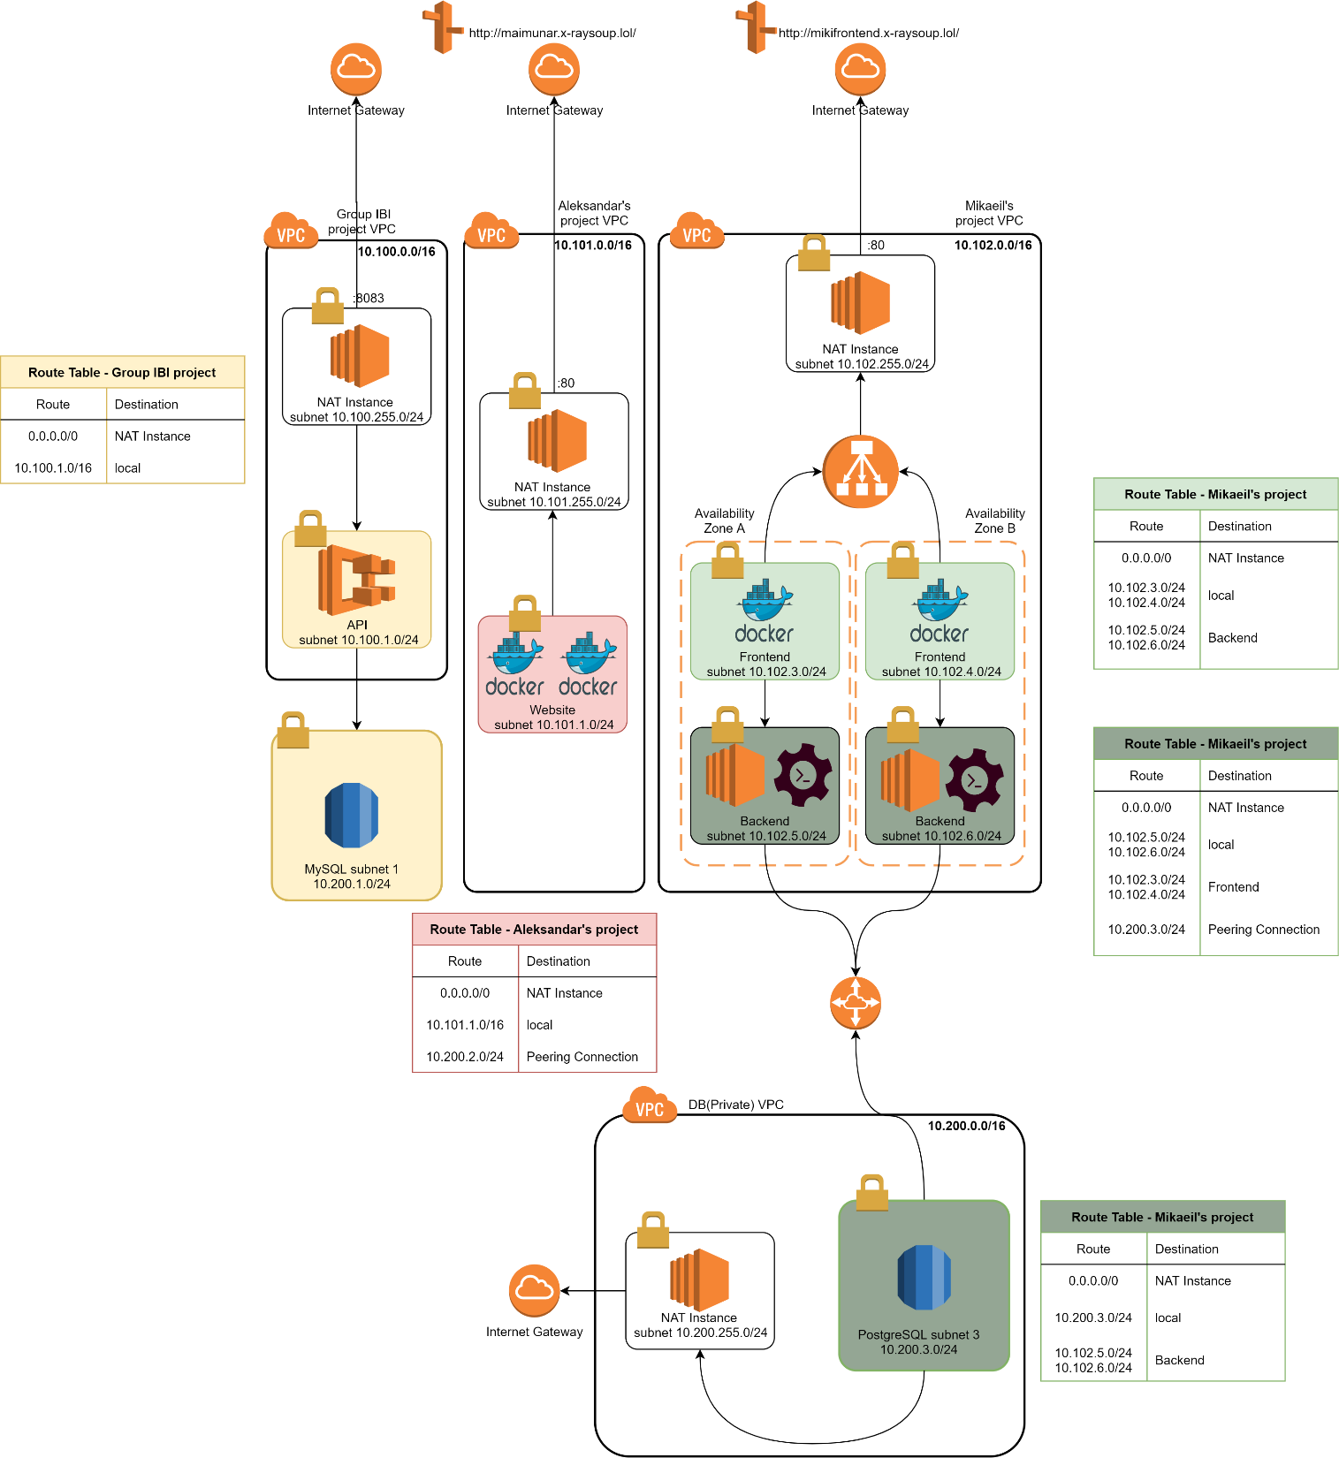

Slide 4



Mikaeil Project
Infrastructure
Terraform Scripts
Ansible playbooks
Apache2-flask playbook
Dockerized Container
IAM accounts with restrictions
User Manuals

Slide 5
Automation & Orchestration
Automated GitHub repo clone and configuration of Flask and Apache
Continuous Deployment – After push to GitHub, it builds an image in DockerHub, and WatchTower container deploys it automatically
Automated deployment of the infrastructure, without software installation

Slide 6


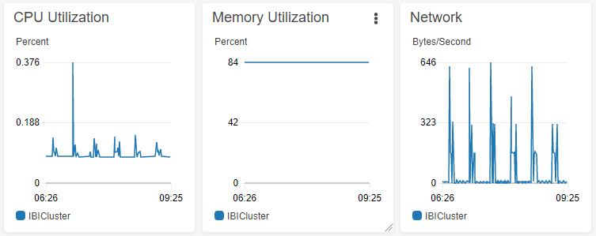
Multidisciplinary project - IBI Project
ECS Cluster
Advanced Container Monitoring
Publicly available database

Slide 7
ECS Cluster
ECR – used to register container images
Cluster – Networking + EC2 Linux
Port Forwarding to Access API securely through NAT Instance
Utilization of container insights to build dashboards
Docker

Slide 8

Multidisciplinary project - Aleksandar Ivanov
Dockerized Container
Frontend
Backend
Route 53

Slide 9

Constraints and difficulties
Communication
Lack of experience
Over-estimation of our capabilities
Planning
Undefined project scope

Slide 10
Q&A and Demo

Slide 11
Thank you for your attention!
☺☺☺

